Slide 1
Aging in Iowa: implications for policy
Jennifer Margrett and Nichole Seedorf
Gerontology Program
Iowa State University
E-mail: margrett@iastate.edu
Phone: (515) 294-3028

Slide 2
Overview
Aging and the aging of Iowa
Relevance to Iowa and our communities
Aging in place and caregiving
Preparing an ample and educated workforce

Slide 3
Growing and diverse aging population

Slide 4
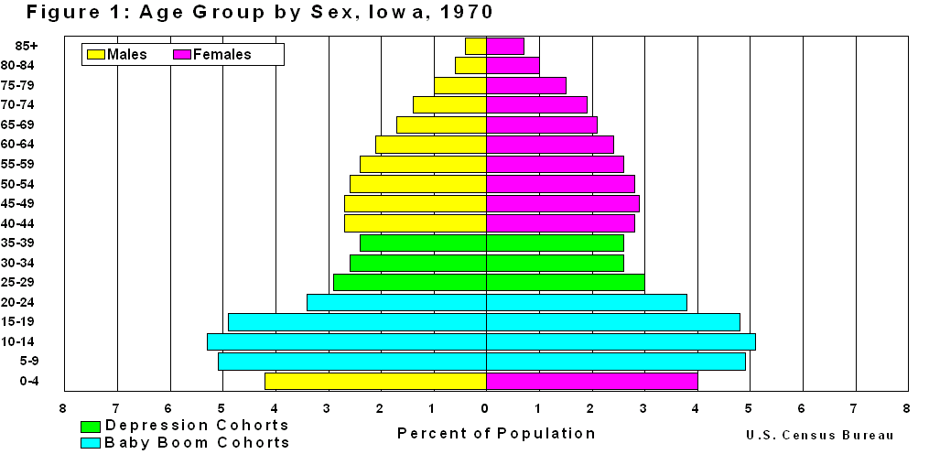
The Past

Slide 5
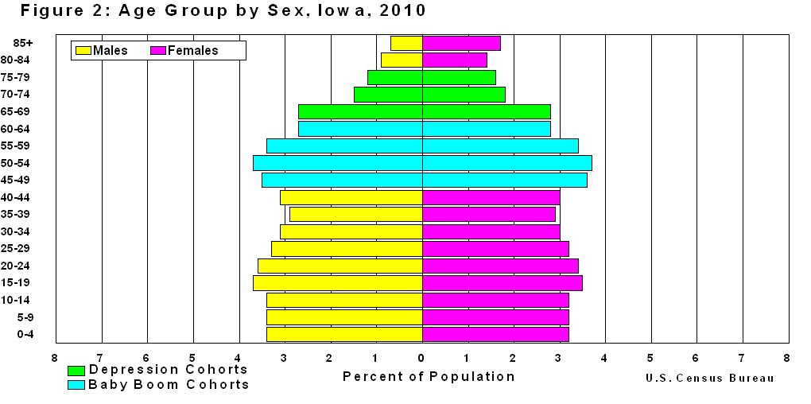
The Present

Slide 6
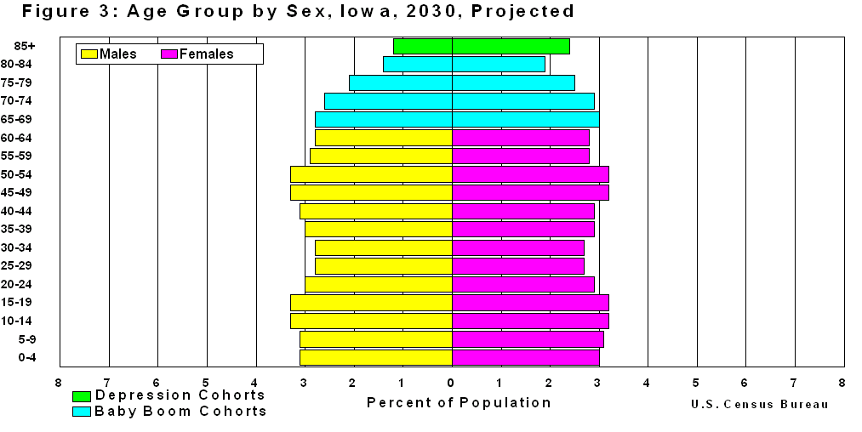
The Future
The US will soon approach 20% older adult population, on our way to 25%.
Older adults will quickly outnumber children <5 and then all children < 14. Growth includes the “oldest old,” aged 90+.

Slide 7
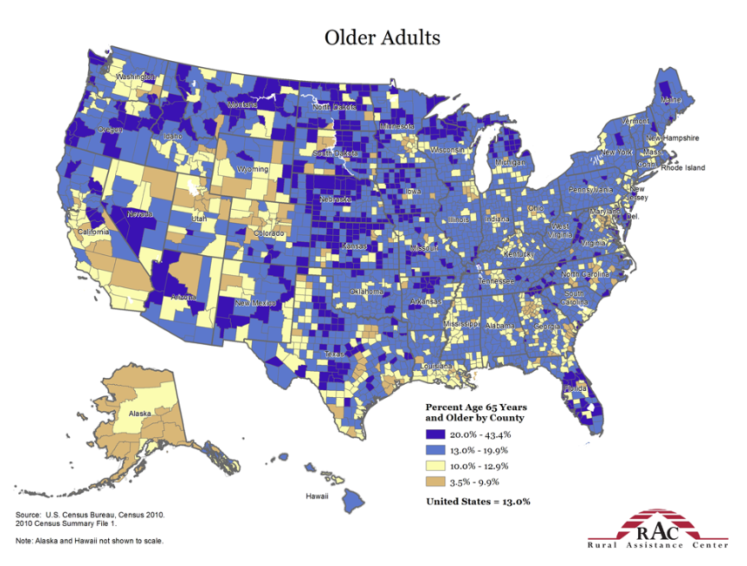
http://www.raconline.org/racmaps/mapfiles/elderly.jpg

Slide 8
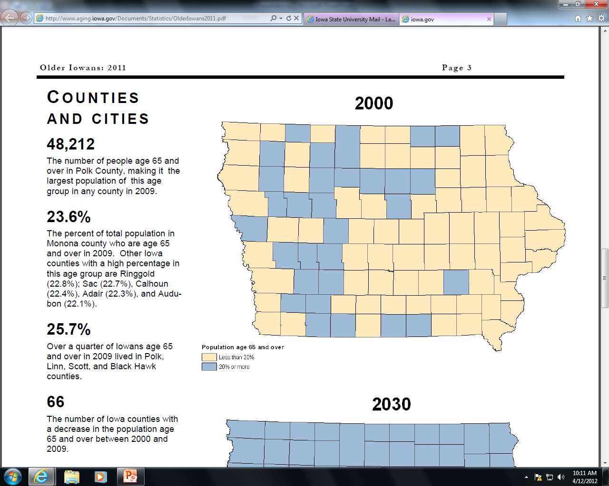
Aging of Iowa
= less than 20%
= 20% or more
State Data Center of Iowa and the Iowa Department on Aging (2011)

Slide 9
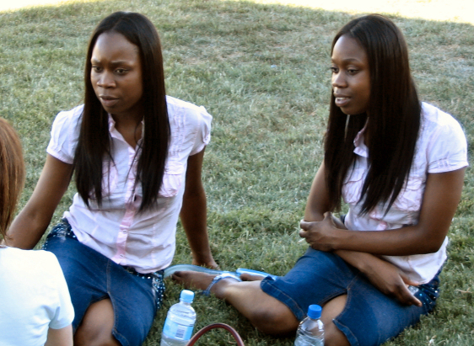
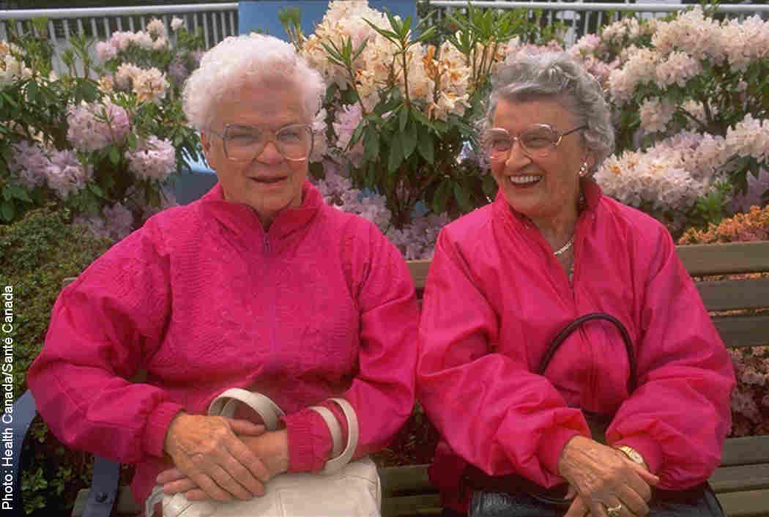
Myths about Aging
All older adults have or eventually develop dementia
Most older adults live in nursing homes
After retirement, older adults don’t do anything
Everyone over 65 is depressed
Two 25-year-olds will be more alike than two 75-year-olds!

Slide 10



Slide 11
Diversity within the Aging Population
Young Old: 65-74
Old: 75-90
Oldest-old: 90+
45-64
The group of persons labeled “older adults” is very diverse
  --Increasing number of men, individuals with
  disabilities, and language and cultural diversity
Age span: 60-100+
Cohort/generation
(e.g., Baby Boomers 1946-1964)
Sexual orientation
Resources
Functional ability
Technology, social media
Motivation/preferences

Slide 12
Optimal
Aging
Physical Health
Mental Health
Life Satisfaction
Cognition
Health Behaviors
Social Contact, Support
Modified from Parslow, R. A., Lewis, V. J., & Nay, R. (2011). Successful aging: Development and testing of a multidimensional model using data from a large sample of older Australians. JAGS, 59, 2077-2083.

Slide 13

Ripple Effect of Aging: Bioecological Lens
Society
Community
Partners
Family
Friends

Slide 14
Relevance to iowa and our communities

Slide 15
Iowa Aging
Iowa is one of the oldest states, particularly among older age groups (Administration on Aging, 2014)
  60+: 7th (Florida, West Virginia, Maine, Pennsylvania, Montana, Vermont)
  65+: 5th (Florida, West Virginia, Maine, Montana)
  75+: 4th (Florida, Pennsylvania, North Dakota)
  85+: 3th (Rhode Island, North Dakota)
Average US life expectancy = 78.1; Iowa = 79.7 (Measure of America, 2014)
  Health indicators (top 1/3-1/2, but below neighbors)
Iowa communities
  High percentage of Iowans live in rural locations
  Potential out migration of younger adults and families

Slide 16
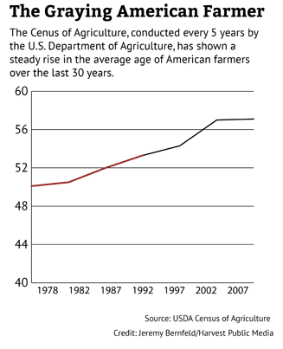
Iowa Aging
National average retirement age is 62 (Gallup Economy, 2014)
  Volunteering:
  1/3 of Iowans 50+ volunteer, with 50% increase of 65+ projected nationally in next decade (Corporation for National and Community Service, 2014)
http://harvestpublicmedia.org/article/retirement-not-farm-farmers-working-later

Slide 17
Iowa Aging
Diversity of households and families
  1/3 of older Iowans live alone (State Data Center of Iowa and the Iowa Department on Aging, 2011)
    46% of women 75+ (AOA, 2013)
  31,442 older Iowans living with grandchildren→42% have custody and 25% of the guardians have a disability (State Data Center of Iowa, 2013)
  29,000 older Iowans live with cognitive impairment (State Data Center of Iowa and the Iowa Department on Aging, 2011)
  11.2% of Iowans 60 and older are marginally food insecure (United, 2013)
  10.2% of older Iowans report little to no provision of social or emotional support (Administration on Aging, 2012)
There is not a “typical” profile of aging

Slide 18

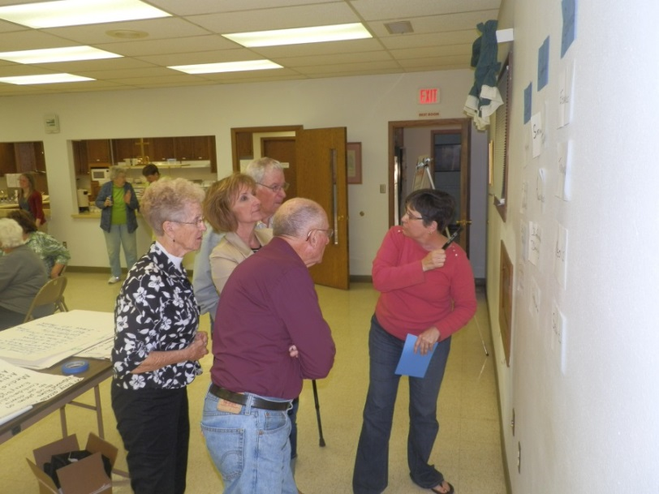
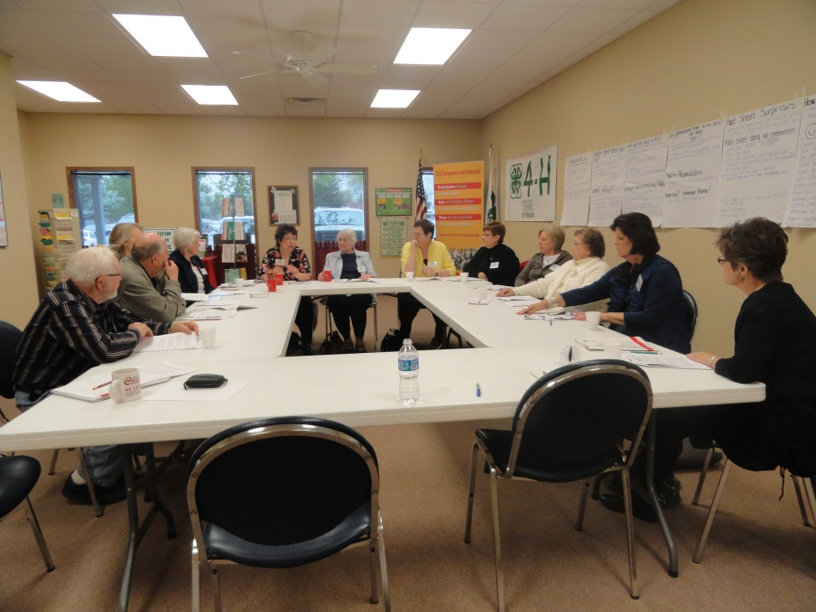
Community-driven, all age structured conversations about aging in Iowa communities
  15 communities, ~200 participants aged 24-93
Followed by action forum and work groups
Supported by Iowa State University Extension and Outreach

Slide 19
Midlife and Beyond: Findings to Date
Community strengths
  Friendly, safe, healthy, and strong sense of community
Common Needs
  Vitality of the community
  Understanding aging-related issues and caregiving
  Access to resources
  Housing
  Transportation
  Intergenerational connections
Uniqueness across communities
  Understanding policies at local, state, & national levels
  Identifying resources
  Technology access and education
  Expanding social network
  Preventative programs

Slide 20

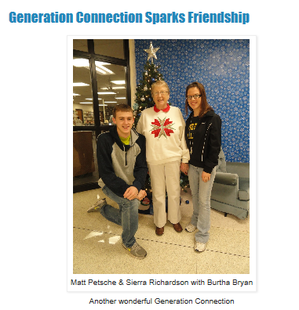
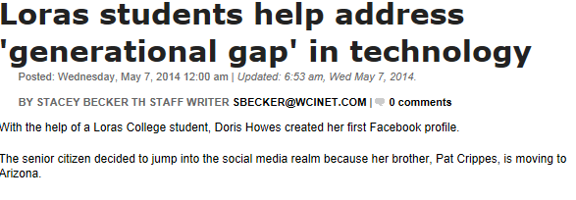


Slide 21
Aging and Caregiving in iowa

Slide 22
Challenges to Aging in Place within Iowa
93% of Iowans aged 50+ say it is important to be able to stay in their own homes as they age
Compared to other states:
  Iowa is #2 in largest percentage of total population in nursing facilities (i.e., 25,000 individuals in 2011; The Henry J. Kaiser Family Foundation, 2013)
  Iowa #4 in the proportionate number of nursing facility residents with low care needs (i.e., 26% compared to 15% nationally; State of Iowa Department on Aging, 2013)

Slide 23
Challenges to Aging in Place within Iowa
Medicaid dollars supporting one adult in a nursing home could support ~three adults using home and community-based services (Reinhard, Kassner, & Houser, 2011)
Characteristics of caregivers
  Early caregivers may not identify as “caregivers”
  Females, likely older themselves or part of the sandwich generation
  Lack of awareness and understanding
Caregivers often indicate it did not occur to them to seek out long-term support services (LTSS) in order to meet the care recipient’s needs (Casado, van Vulpen, & Davis, 2011)
  Iowa caregivers only aware of ~60% of LTSS types

Slide 24
Long-Term Services & Supports Types
Service Type
Adult Day Center | Home Health Aide
Assisted Living Facility | Home Delivered Meals
Bill Payer | Homemaker Services
Case Management - Private | Medication Aide
Case Management - Public | Nursing Care - In Home
Chore Services | Nursing Care - Facility
Consumer Directed Attendant Care | Nursing Care - Skilled Facility
Continuing Care Community | Nutrition Counseling
Counseling/Emotional Support | Personal Care Services
Errands and Shopping | Personal Emergency Response Device
Financial Management | Remote Electronic Monitoring
Legal Assistance | Respite Care
Information and Referral | Transportation

Slide 25
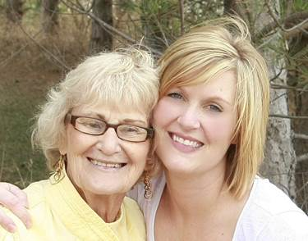
Caregiver Beginnings Workshop
One-session workshop for Iowans in the first year of caregiving or who expect to be caregiving soon
Topics include: Legal & healthcare documents, falls, driving, locating
resources, and designing a care plan
Link caregivers with familiar community organizations
  Community leaders may be familiar with nursing homes / assisted living and homemaker services
Project supported by the Iowa State University Graduate College

Slide 26
Preliminary Workshop Findings
Very few participants have an existing care plan; Most deal with crises as they occur
Two types of pre-facility informal caregivers:
  Early-stage limited care needs provided by family
  Intermediate-stage increasing care needs, high caregiver stress, uncertain of LTSS use
Personal care needs and supervision drive nursing home use

Slide 27
Preliminary Workshop Findings

Slide 28
Workforce preparation

Slide 29
Preparing the Needed Workforce
Healthcare professional shortage already exists in many areas of Iowa
  ~75,000 persons are employed as direct care workers in long-term care settings in Iowa, representing the largest workforce in the state with expected need for an additional 20,000 professional caregivers by 2020 (Iowa Caregivers Association, 2014)
Aging is related to many of the growing careers identified by the Bureau of Labor Statistics
  Education (continuing, lifelong), health care and wellness, human services, intergenerational programming, technology, construction and design, marketing, events, human resources, and entrepreneurial
Need to grow a multidisciplinary, well-trained workforce which can promote whole-person wellness across the life span

Slide 30
Understanding Undergraduate Aging Experiences: Preliminary Results
N = 1,029 across Iowa State University colleges
Personal experience
  19% had resided with someone 60+ in last five years
  79% never-occasionally have daily contact with someone 60+
College experience
  73% did not feel aging was addressed in coursework
  39% had a formal practicum or internship with 60+
Project funded by Iowa State University College of Human Sciences

Slide 31
Understanding Undergraduate Aging Experiences: Preliminary Results
56% (strongly) agreed that understanding more about aging will be essential to future job success
Age Group | Percentage (multiple endorsements possible)
Infants | 6%
Young children | 14%
Adolescents | 23%
Younger adults | 80%
Middle-aged adults | 89%
Older adults | 65%

Slide 32

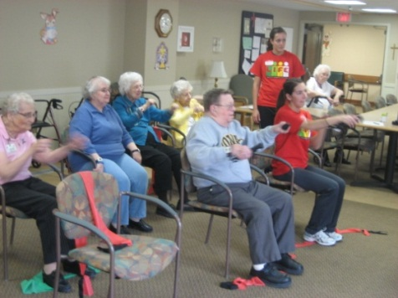
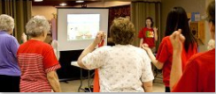
Training and intergenerational contact was related to increased aging knowledge and positive expectations as well as decreased ageism
  “[I enjoyed] being able to get to know the participants and watching their physical and emotional changes.”
  “There is so much to learn from them.”
Project funded by the USDA; Francis, et al (under review)

Slide 33
summary

Slide 34
Aging in Iowa
Aging Population
  Growing, diverse
  Life-span, whole-person wellness
Caregiving
  Desire to age in place
  Under-utilization of long-term support services
  Intergenerational implications
Community
  Rural challenges & each community’s uniqueness
  Economics & sustainability
Workforce Preparation
  Shortage of prepared workers across occupations
  Benefits of increased contact and exposure to aging content and career information

Slide 35
Aging in Iowa: Policy Implications
Proactive life-span wellness
Education regarding aging at all levels
Older adults as an asset with economic impact
Aging, disability, and caregiving resources
  Abundance, awareness, access
    (single-access approach; multiple delivery methods→ technology)
  Caregiver support (e.g., workplace)
Consideration of diverse needs and preferences
  Autonomy and aging in place
  Person and family-centered approaches
Society
Community
Partners
Family
Friends

Slide 36
References
Administration on Aging (2012, June 18-19). Iowa: Policy academy state profile. Retrieved from: http://www.aoa.gov/AoARoot/AoA_Programs/HPW/Behavioral/docs/Iowa.pdf
Administration on Aging (2014). Population based on age: Ranked by percent. Retrieved from: http://www.aoa.gov/AoARoot/Aging_Statistics/Census_Population/census2010/Index.aspx
Bureau of Labor Statistics (2013). Fastest growing occupations. Retrieved from: http://www.bls.gov/emp/ep_table_103.htm
Casado, B. L., van Vulpen, K. S., & Davis, S. L. (2011). Unmet needs for home and community-based services among frail older Americans and their caregivers. Journal of Aging and Heath, 23(3), 529-553.
Corporation for National and Community Service (2014). Volunteering and civic engagement in Iowa. Retrieved from:
http://www.volunteeringinamerica.gov/IA
Gallup Economy (2014). Average U.S. Retirement Age Rises to 62. Retrieved from: http://www.gallup.com/poll/168707/average-retirement-age-rises.aspx

Slide 37
References
Harvest Public Media (2014). Retirement? Not on the farm. Retrieved from: http://harvestpublicmedia.org/article/retirement-not-farm-farmers-working-later
The Henry J. Kaiser Family Foundation. (2013). Total Number of Residents in Certified Nursing Facilities. Retrieved from State Health Facts: http://kff.org/other/state-indicator/number-of-nursing-facility-residents/#
Iowa Caregivers Association (2014). http://www.iowacaregivers.org/
Iowa Department on Aging. (2013). Iowa State Plan on Aging FFY 2014-2015. Des Moines: State of Iowa.
Living well through Intergenerational Fitness and Exercise (LIFE; 2014). Retrieved from: http://www.extension.iastate.edu/life
Measure of America (2014). Mapping the measure of America. Retrieved from: http://www.measureofamerica.org/maps/
Midlife and Beyond: The Whole Picture (2014). Retrieved from: http://www.extension.iastate.edu/humansciences/midlife-and-beyond

Slide 38
References
Parslow, R. A., Lewis, V. J., & Nay, R. (2011). Successful aging: Development and testing of a multidimensional model using data from a large sample of older Australians. JAGS, 59, 2077-2083.
Reinhard, S. C., Kassner, E., & Houser, A. (2011). How the affordable care act can help move states toward a high-performing system of long-term services and supports. Health Affairs, 30(3), 447-453. doi:10.1377/hlthaff.2011.0099
Rural Assistance Center (2014). Retrieved from: http://www.raconline.org/racmaps/mapfiles/elderly.jpg
State Data Center of Iowa (2013). Iowans with disabilities: 2013. Retrieved from: http://www.iowadatacenter.org/Publications/dis13.pdf
State Data Center of Iowa and the Iowa Department on Aging (2011). Retrieved from: http://www.iowadatacenter.org/Publications/olderIowans2011.pdf
United Health Foundation. (2013). 2013 - Americas Health Rankings report – State Health Statistics brought to you by AmericasHealthRankings.org. . Retrieved from: http://www.americashealthrankings.org/IA/food_insecurity_sr/2013

